Slide 1
Prevent Self-Assessment Toolkit for Schools

Slide 2
A reminder – The Prevent Statutory Duty
Counter Terrorism & Security Act 2015
The Prevent Statutory Duty:
“to have due regard to the need to prevent people from being drawn into terrorism”
The Duty applies to “specified authorities” who are inspected for compliance by Ofsted (utilising their Education Inspection Framework), this of course includes schools.
Requirements:
Risk Assessment
Prevent Action Plan
Partnership
Staff training
Welfare and pastoral care
Safety online
Speakers and events

Slide 3
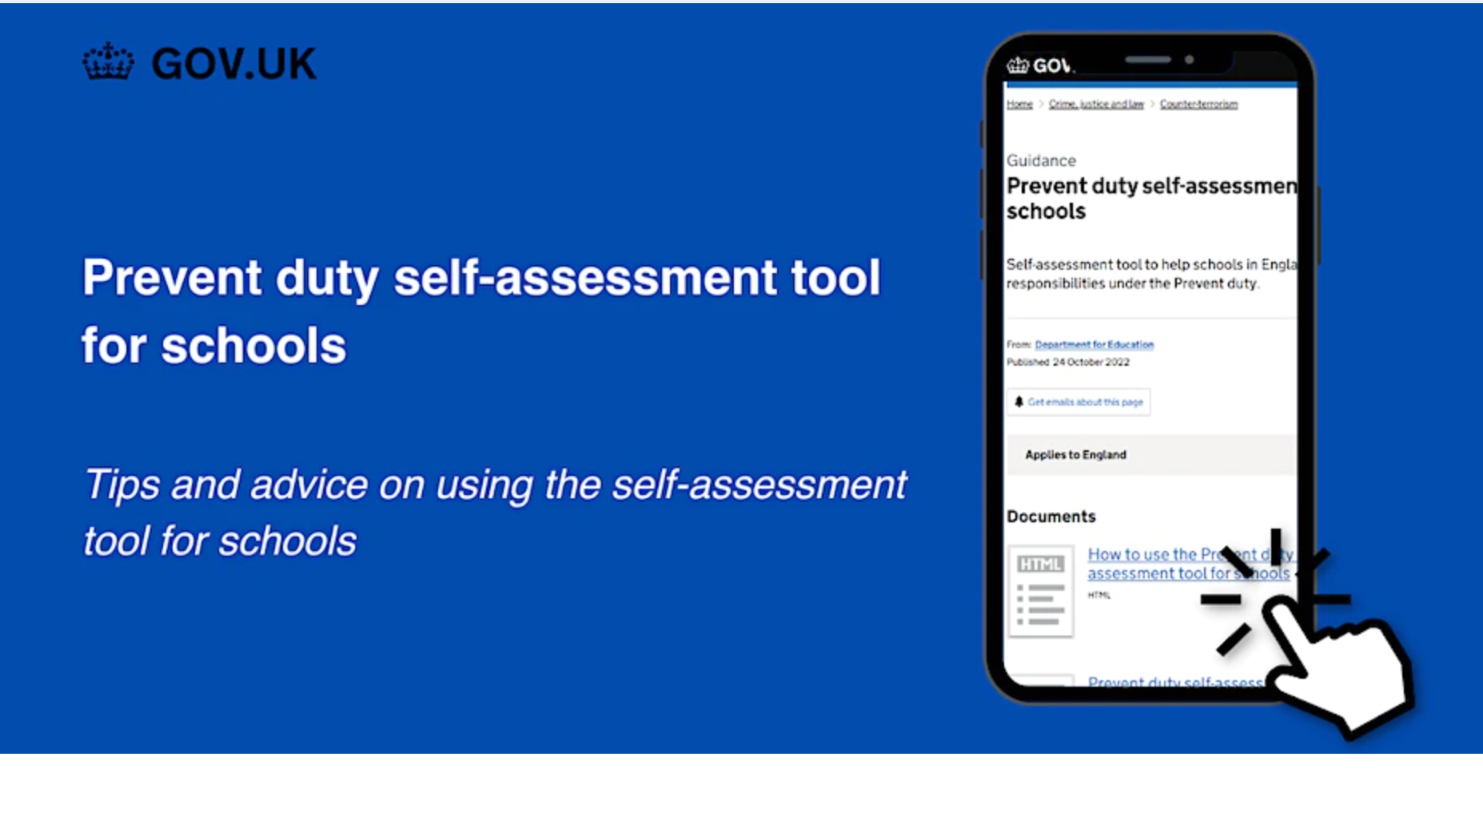
Prevent Self-Assessment Toolkit for Schools in England

Slide 4
Prevent Self-Assessment Toolkit for Schools in England
The toolkit is NOT a replacement or alternative to a statutory Prevent risk assessment & action plan
It is intended to be a stand alone resource to support schools to self assess how well their Prevent arrangements are embedded & to identify any gaps & weaknesses
It is not obligatory – it is a resource to support compliance with statutory requirements - but Ofsted are aware of it!
It is intended to raise standards ahead of Ofsted inspection
Robust examination of current Prevent arrangements & collation of EVIDENCE supporting effectiveness WILL improve standards of compliance ahead of Ofsted inspections & keep learners safer

Slide 5
What is the Prevent Self Assessment Tool for Schools?
A self-assessment tool to assist schools to review how well embedded & effective their Prevent responsibilities are in advance of Ofsted inspection.
The Tool deliberately mimics the Ofsted EIF to allow schools to assess:
Their level of Prevent compliance
Align compliance with Ofsted’s EIF grading (1 – 4)
Identify gaps & weaknesses that can be developed to improve safeguarding effectiveness
Support a level of consistency in compliance with the Prevent Duty nationally
Prevent duty self-assessment tool for schools - GOV.UK (www.gov.uk)

Slide 6
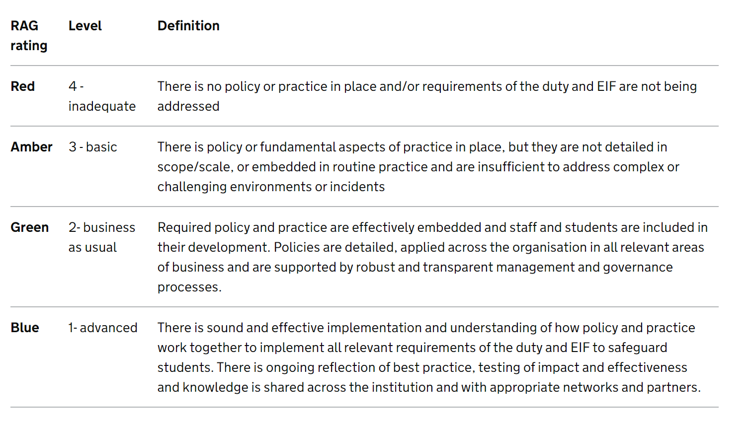
The Prevent SA Tool – How it works
3 Phases of activity:
Evaluation
Action planning
Summary
Outcomes can form part of a schools
Development plan
This can, but doesn’t have to, be
Included in their Prevent Action
Plan.
It can remain confidential.
Ofsted may ask if it has been used
Grading:
Advanced
Business as usual
Basic
Inadequate

Slide 7
The Prevent SA Tool – How it works
7 Distinct areas (requirements) of judgement:
Leadership & Management
Risk Assessment
Working in Partnership
Training
Online Safety
Safeguarding School Premises
Building Children’s Resilience to Radicalisation

Slide 8
The Prevent SA Tool – How it works
Each area links to the Prevent Duty &/or Ofsted’s EIF
Look for robust evidence (not broad statements about activity) to achieve each score
The SA Tool is NOT a replacement for your Statutory requirement of a Prevent Risk Assessment & Action Plan
Be honest with yourself!

Slide 9
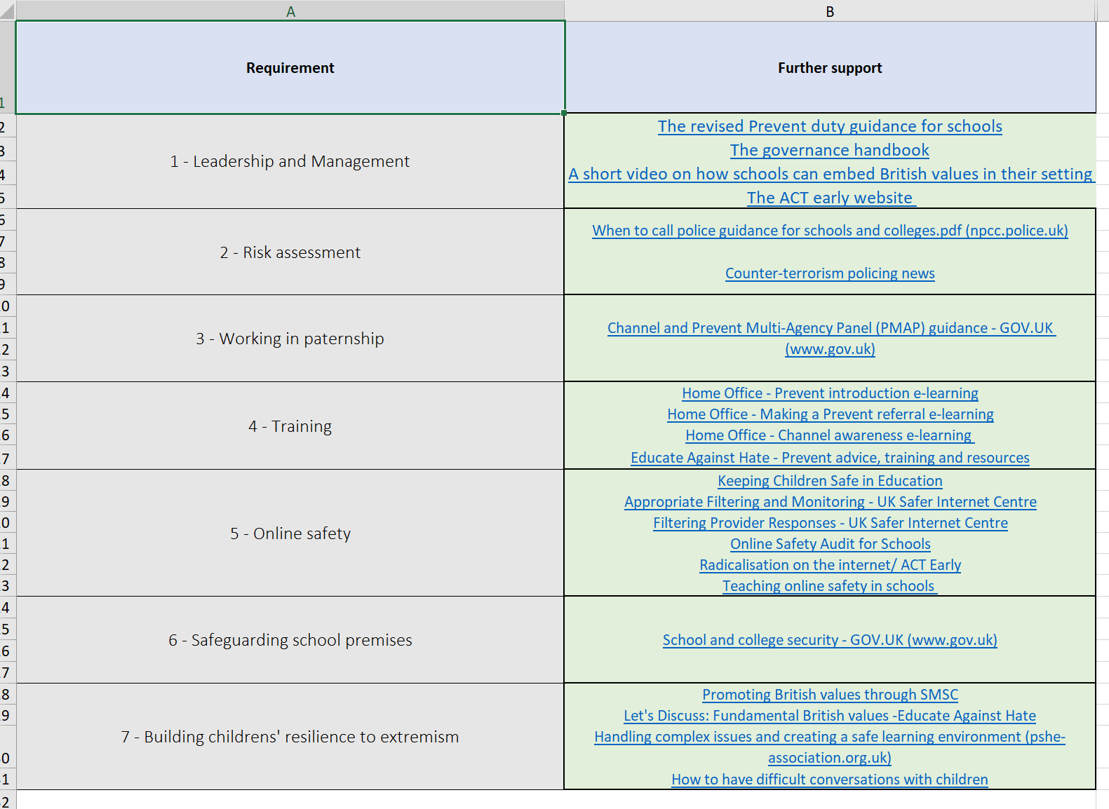
The Prevent SA Tool – How it works
The SA Toolkit contains an Excel spreadsheet that can be downloaded & saved for completion.
Ensure that the “further support links” tab is highlighted to users

Slide 10
“How to use the toolkit webinars”
Tuesday 28th February 2023 10.45am to 11.30am
A webinar to support schools to use the Prevent Self-Assessment Toolkit Tickets, Tue 28 Feb 2023 at 10:45 | Eventbrite
A 45 minute webinar hosted by DfE & supported by Prevent Education Officers to encourage use of & explain how to get the best from the Toolkit

Slide 11
Prevent DSL Handbook
New guidance from the Department for Education to support DSLs safeguard learners vulnerable to radicalisation (DSL Prevent Handbook)
The Department for Education has published new non-statutory guidance for designated safeguarding leads (DSLs) to help them safeguard learners vulnerable to radicalisation.
The guidance is designed to explain the Prevent referral process and statutory responsibilities to keep children, young people and adult learners safe from the risk of extremist ideology or radicalisation. The guidance will help those with safeguarding responsibilities with:
An introduction to the Prevent duty for those with safeguarding responsibilities
Understanding and identifying radicalisation risk in an education setting
Managing risk of radicalisation in an education setting
Prevent case studies
The guidance has been developed by frontline practitioners in local authorities, with support from the Department for Education. It reflects learning since the introduction of the Prevent duty in 2015.

